Slide 1
Pigeonhole Principle, Summation and Sequences

Slide 2
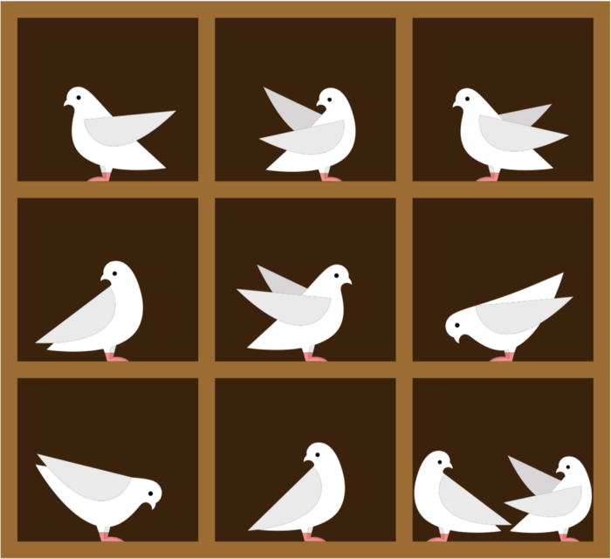
PigeonHole Principle- Counting Argument (Proof Technique)
Principle: If n pigeons are nesting in m pigeonholes, where n > m, then at least one pigeonhole has more than one pigeon.
Example- Among any group of 13 people there must be at least two with the same birth month.
Solution- Consider months in a year as pigeonholes and people as pigeons. Thus, by pigeonhole principle, there exists more than one people having the same birth month.

Slide 3
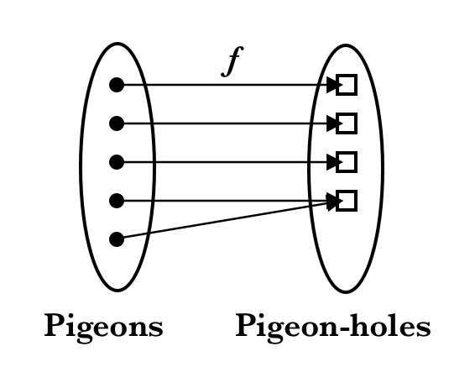
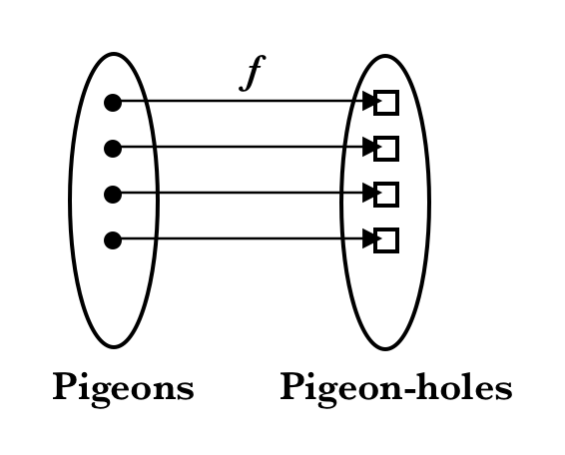
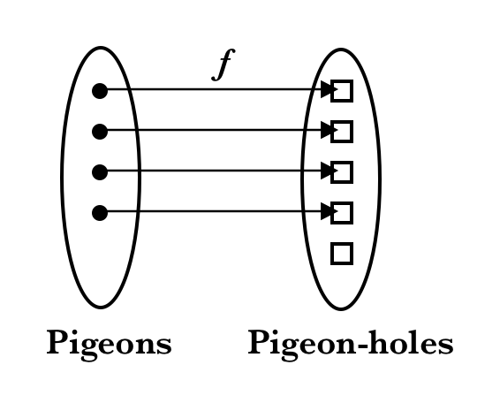
Another View of Pigeonhole principle (Function View)
Formally, think of the pigeonhole principle as the statement about a function f from domain P → PH, where pigeon n flies into pigeonhole f(n), as is shown below:

Slide 4
Another View of Pigeonhole principle (Function View)
The three cases illustrate three types of functions from a domain (“pigeons”) to a codomain “pigeonholes” which can be mapped to one another:
Case A: If |n| > |f(n)|, then the function is a non-injective surjective function (not a bijection)
Case B: If |n|= |f(n)|, then the function is a injective surjective function (bijection)
Case C: If |n| < |f(n)|, then the function is an injective non-surjective function (not a bijection).

Slide 5
Proof of Pigeonhole Principle Strategy- Proof By Contradiction
Suppose that the total number of pigeons n are to be put in m number of pigeonholes and n > m. Assume that there are no pigeonholes with at least n/m pigeons, i.e. that each pigeonhole has less than n/m pigeons:
Number of pigeons in each pigeonhole < n/m
Number of pigeons < m × n/m
Number of pigeons < n
But given that the number of pigeons is strictly equal to n, we have obtained a contradiction to our assumption that each pigeonhole has less than n/m pigeons.
Hence there exists at least one pigeonhole with at least n/m pigeons.

Slide 6
Example
Among any group of 367 people, there must be at least two with the same birth date. Assume that there are 366 days in a year. Prove using PHP.
Solution- The first step in solving PHP based puzzles is to identify pigeons and pigeon holes.
Consider each day in a year as a pigeonhole, i.e., each pigeon hole is labeled as 1-Jan, 2-Jan, 3-Jan, etc., and people as pigeons.
A pigeon (person) is placed in the hole labeled 1-Jan if his birth date is 1-Jan. Since there are 366 pigeons and 367 people, by pigeonhole principle, there exist more than one person having the same birth date.

Slide 7
Extended or Generalized Pigeonhole Principle
Statement- If n pigeons are assigned to m pigeonholes (The number of pigeons is very large than the number of pigeonholes), then one of the pigeonholes must contain at least [(n-1)/m]+1 pigeons.
Proof- Proof-by-contradiction
Assume that each pigeonhole does not contain more than [(n-1)/m] pigeons. Then, there will be at most m[(n-1)/m]≤m(n-1)/m=n-1 pigeons in all. This is in contradiction to our assumptions. Hence, for given m pigeonholes, one of these must contain at least [(n-1)/m]+1 pigeons.

Slide 8
Examples
1. Assuming discrete mathematics follows 4 grade grading pattern - A, B, C, D, what is the minimum number of students required in DM class to be sure that at least six receive the same grade.
Solution- Consider grades as pigeonholes, then m=4.
So, [(n-1)/m]+1=6 => n= 21
2. What’s the minimum number of students, each of whom comes from one of the 50 states must be enrolled in a university to guarantee that there are at least 100 who come from the same state?
50*99 + 1 = 4951
⎡4951/50⎤ = 100
3. There are 38 different time periods during which classes at a university can be scheduled. If there are 677 different classes, how many different rooms will be needed?
⎡677/38⎤ = 18

Slide 9
Challenging Questions
Prove that in a group of n people, there exist at least two with equal number of friends.
Solution-Observe that the number of friends a person can have is in the range 0 to n − 1. Interestingly, we can observe some interesting facts as follows. Note that if a person has n − 1 friends, then there does not exist a person having 0 friends. Similarly, If there exist a person having 0 friends, then there does not exist a person having n − 1 friends. It follows that the number of friends ranges from 0 to n − 2 or 1 to n − 1. Therefore we see two cases, and in both, there exist n − 1 distinct numbers (pigeonholes) which represents the cardinality n of the number of friends of a person (pigeons). Therefore by pigeonhole principle, there exist at least two people with the same cardinality representing the number of friends they have.

Slide 10
Challenging Questions
A computer network consists of six computers. Each computer is directly connected to zero or more of the other computers. Show that there are at least two computers that are directly connected to the same number of other computers.
Solution:
Each computer can be directly connected to 0,1,2,3,4,5.
But there are really only five choices, not six, since if one computer is connected to zero other computers, then no computer can be connected to five others. Six computers, 5 choices. Pigeonhole principle says that at least two must have the same number of direct connections.

Slide 11
Sequences and Summations

Slide 12
Definitions
Sequence: an ordered list of elements
Like a set, but:
Elements can be duplicated
Elements are ordered

Slide 13
Sequences
A sequence is a function from a subset of Z to a set S
Usually from the positive or non-negative ints
a_{n} is the image of n
a_{n} is a term in the sequence
{a_{n}} means the entire sequence
The same notation as sets!

Slide 14
Sequence examples
a_{n} = 3n
The terms in the sequence are a₁, a₂, a₃, …
The sequence {a_{n}} is { 3, 6, 9, 12, … }
b_{n} = 2^{n}
The terms in the sequence are b₁, b₂, b₃, …
The sequence {b_{n}} is { 2, 4, 8, 16, 32, … }
Note that sequences are indexed from 1
Not in all other textbooks, though!

Slide 15
Geometric vs. arithmetic sequences
The difference is in how they grow
Arithmetic sequences increase by a constant amount
a_{n} = 3n
The sequence {a_{n}} is { 3, 6, 9, 12, … }
Each number is 3 more than the last
Of the form: f(x) = dx + a
Geometric sequences increase by a constant factor
b_{n} = 2^{n}
The sequence {b_{n}} is { 2, 4, 8, 16, 32, … }
Each number is twice the previous
Of the form: f(x) = ar^{x}

Slide 16
Fibonacci sequence
Sequences can be neither geometric or arithmetic
F_{n} = F_{n-1} + F_{n-2}, where the first two terms are 1
Alternative, F(n) = F(n-1) + F(n-2)
Each term is the sum of the previous two terms
Sequence: { 1, 1, 2, 3, 5, 8, 13, 21, 34, 55, … }
This is the Fibonacci sequence
Full formula:

Slide 17
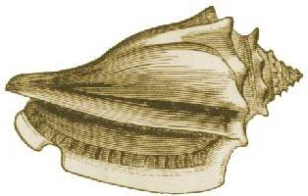
Fibonacci sequence in nature
13
8
5
3
2
1

Slide 18
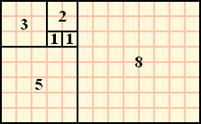
Fibonacci sequence
Another application:
Fibonacci references from http://en.wikipedia.org/wiki/Fibonacci_sequence

Slide 19
Determining the sequence formula
Given values in a sequence, how do you determine the formula?
Steps to consider:
Is it an arithmetic progression (each term a constant amount from the last)?
Is it a geometric progression (each term a factor of the previous term)?
Does the sequence it repeat (or cycle)?
Does the sequence combine previous terms?
Are there runs of the same value?

Slide 20
Determining the sequence formula
1, 0, 1, 1, 0, 0, 1, 1, 1, 0, 0, 0, 1, …
The sequence alternates 1’s and 0’s, increasing the number of 1’s and 0’s each time
1, 2, 2, 3, 4, 4, 5, 6, 6, 7, 8, 8, …
This sequence increases by one, but repeats all even numbers once
1, 0, 2, 0, 4, 0, 8, 0, 16, 0, …
The non-0 numbers are a geometric sequence (2^{n}) interspersed with zeros
3, 6, 12, 24, 48, 96, 192, …
Each term is twice the previous: geometric progression
a_{n} = 3*2^{n-1}

Slide 21
Determining the sequence formula
15, 8, 1, -6, -13, -20, -27, …
Each term is 7 less than the previous term
a_{n} = 22 - 7n
3, 5, 8, 12, 17, 23, 30, 38, 47, …
The difference between successive terms increases by one each time
a₁ = 3, a_{n} = a_{n-1} + n
a_{n} = n(n+1)/2 + 2
2, 16, 54, 128, 250, 432, 686, …
Each term is twice the cube of n
a_{n} = 2*n³
2, 3, 7, 25, 121, 721, 5041, 40321
Each successive term is about n times the previous
a_{n} = n! + 1
My solution: a_{n} = a_{n-1} * n - n + 1

Slide 22
OEIS: Online Encyclopedia of Integer Sequences
Online at http://www.research.att.com/~njas/sequences/

Slide 23
Useful sequences
n² = 1, 4, 9, 16, 25, 36, …
n³ = 1, 8, 27, 64, 125, 216, …
n⁴ = 1, 16, 81, 256, 625, 1296, …
2^{n} = 2, 4, 8, 16, 32, 64, …
3^{n} = 3, 9, 27, 81, 243, 729, …
n! = 1, 2, 6, 24, 120, 720, …

Slide 24
Summations
A summation:
or
is like a for loop:
int sum = 0;
for ( int j = m; j <= n; j++ )
sum += a(j);
upper limit
lower limit
index of
summation

Slide 25
Evaluating sequences
2 + 3 + 4 + 5 + 6 = 20
(-2)⁰ + (-2)¹ + (-2)² + (-2)³ + (-2)⁴ = 11
3 + 3 + 3 + 3 + 3 + 3 + 3 + 3 + 3 + 3 = 30
(2¹-2⁰) + (2²-2¹) + (2³-2²) + … (2¹⁰-2⁹) = 511
Note that each term (except the first and last) is cancelled by another term

Slide 26
Evaluating sequences
Let S = { 1, 3, 5, 7 }
What is Σ_{j∈S} j
1 + 3 + 5 + 7 = 16
What is Σ_{j∈S} j²
1² + 3² + 5² + 7² = 84
What is Σ_{j∈S} (1/j)
1/1 + 1/3 + 1/5 + 1/7 = 176/105
What is Σ_{j∈S} 1
1 + 1 + 1 + 1 = 4

Slide 27
Summation of a geometric series
Sum of a geometric series:
Example:

Slide 28
Proof of last slide
If r = 1, then the sum is:

Slide 29
Double summations
Like a nested for loop
Is equivalent to:
int sum = 0;
for ( int i = 1; i <= 4; i++ )
for ( int j = 1; j <= 3; j++ )
sum += i*j;

Slide 30
Useful summation formulae
Well, only 1 really important one:

